Slide 1
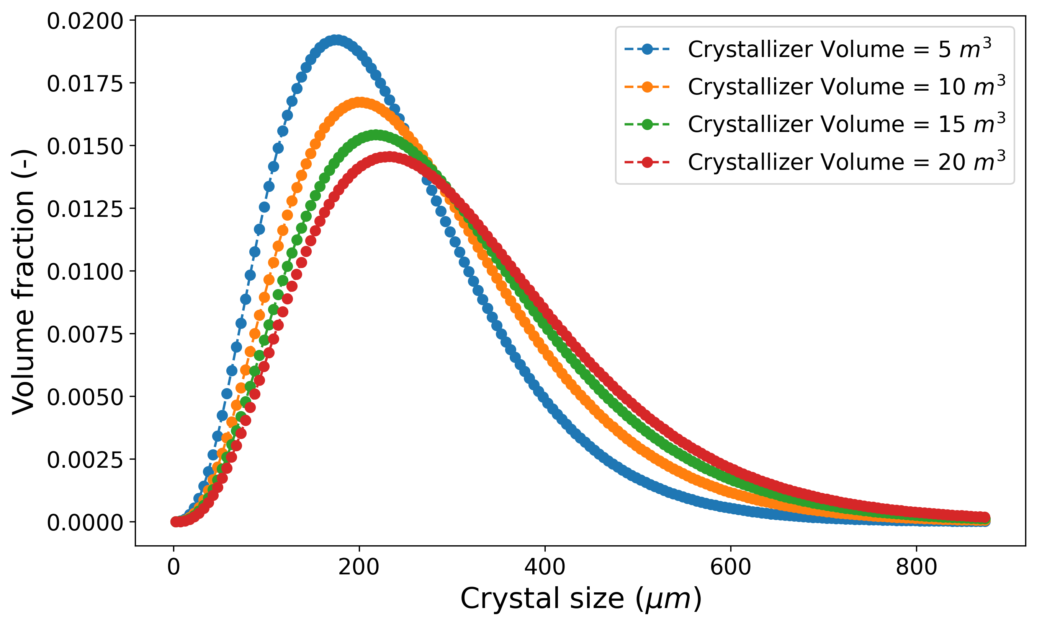
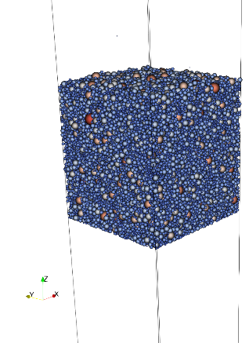
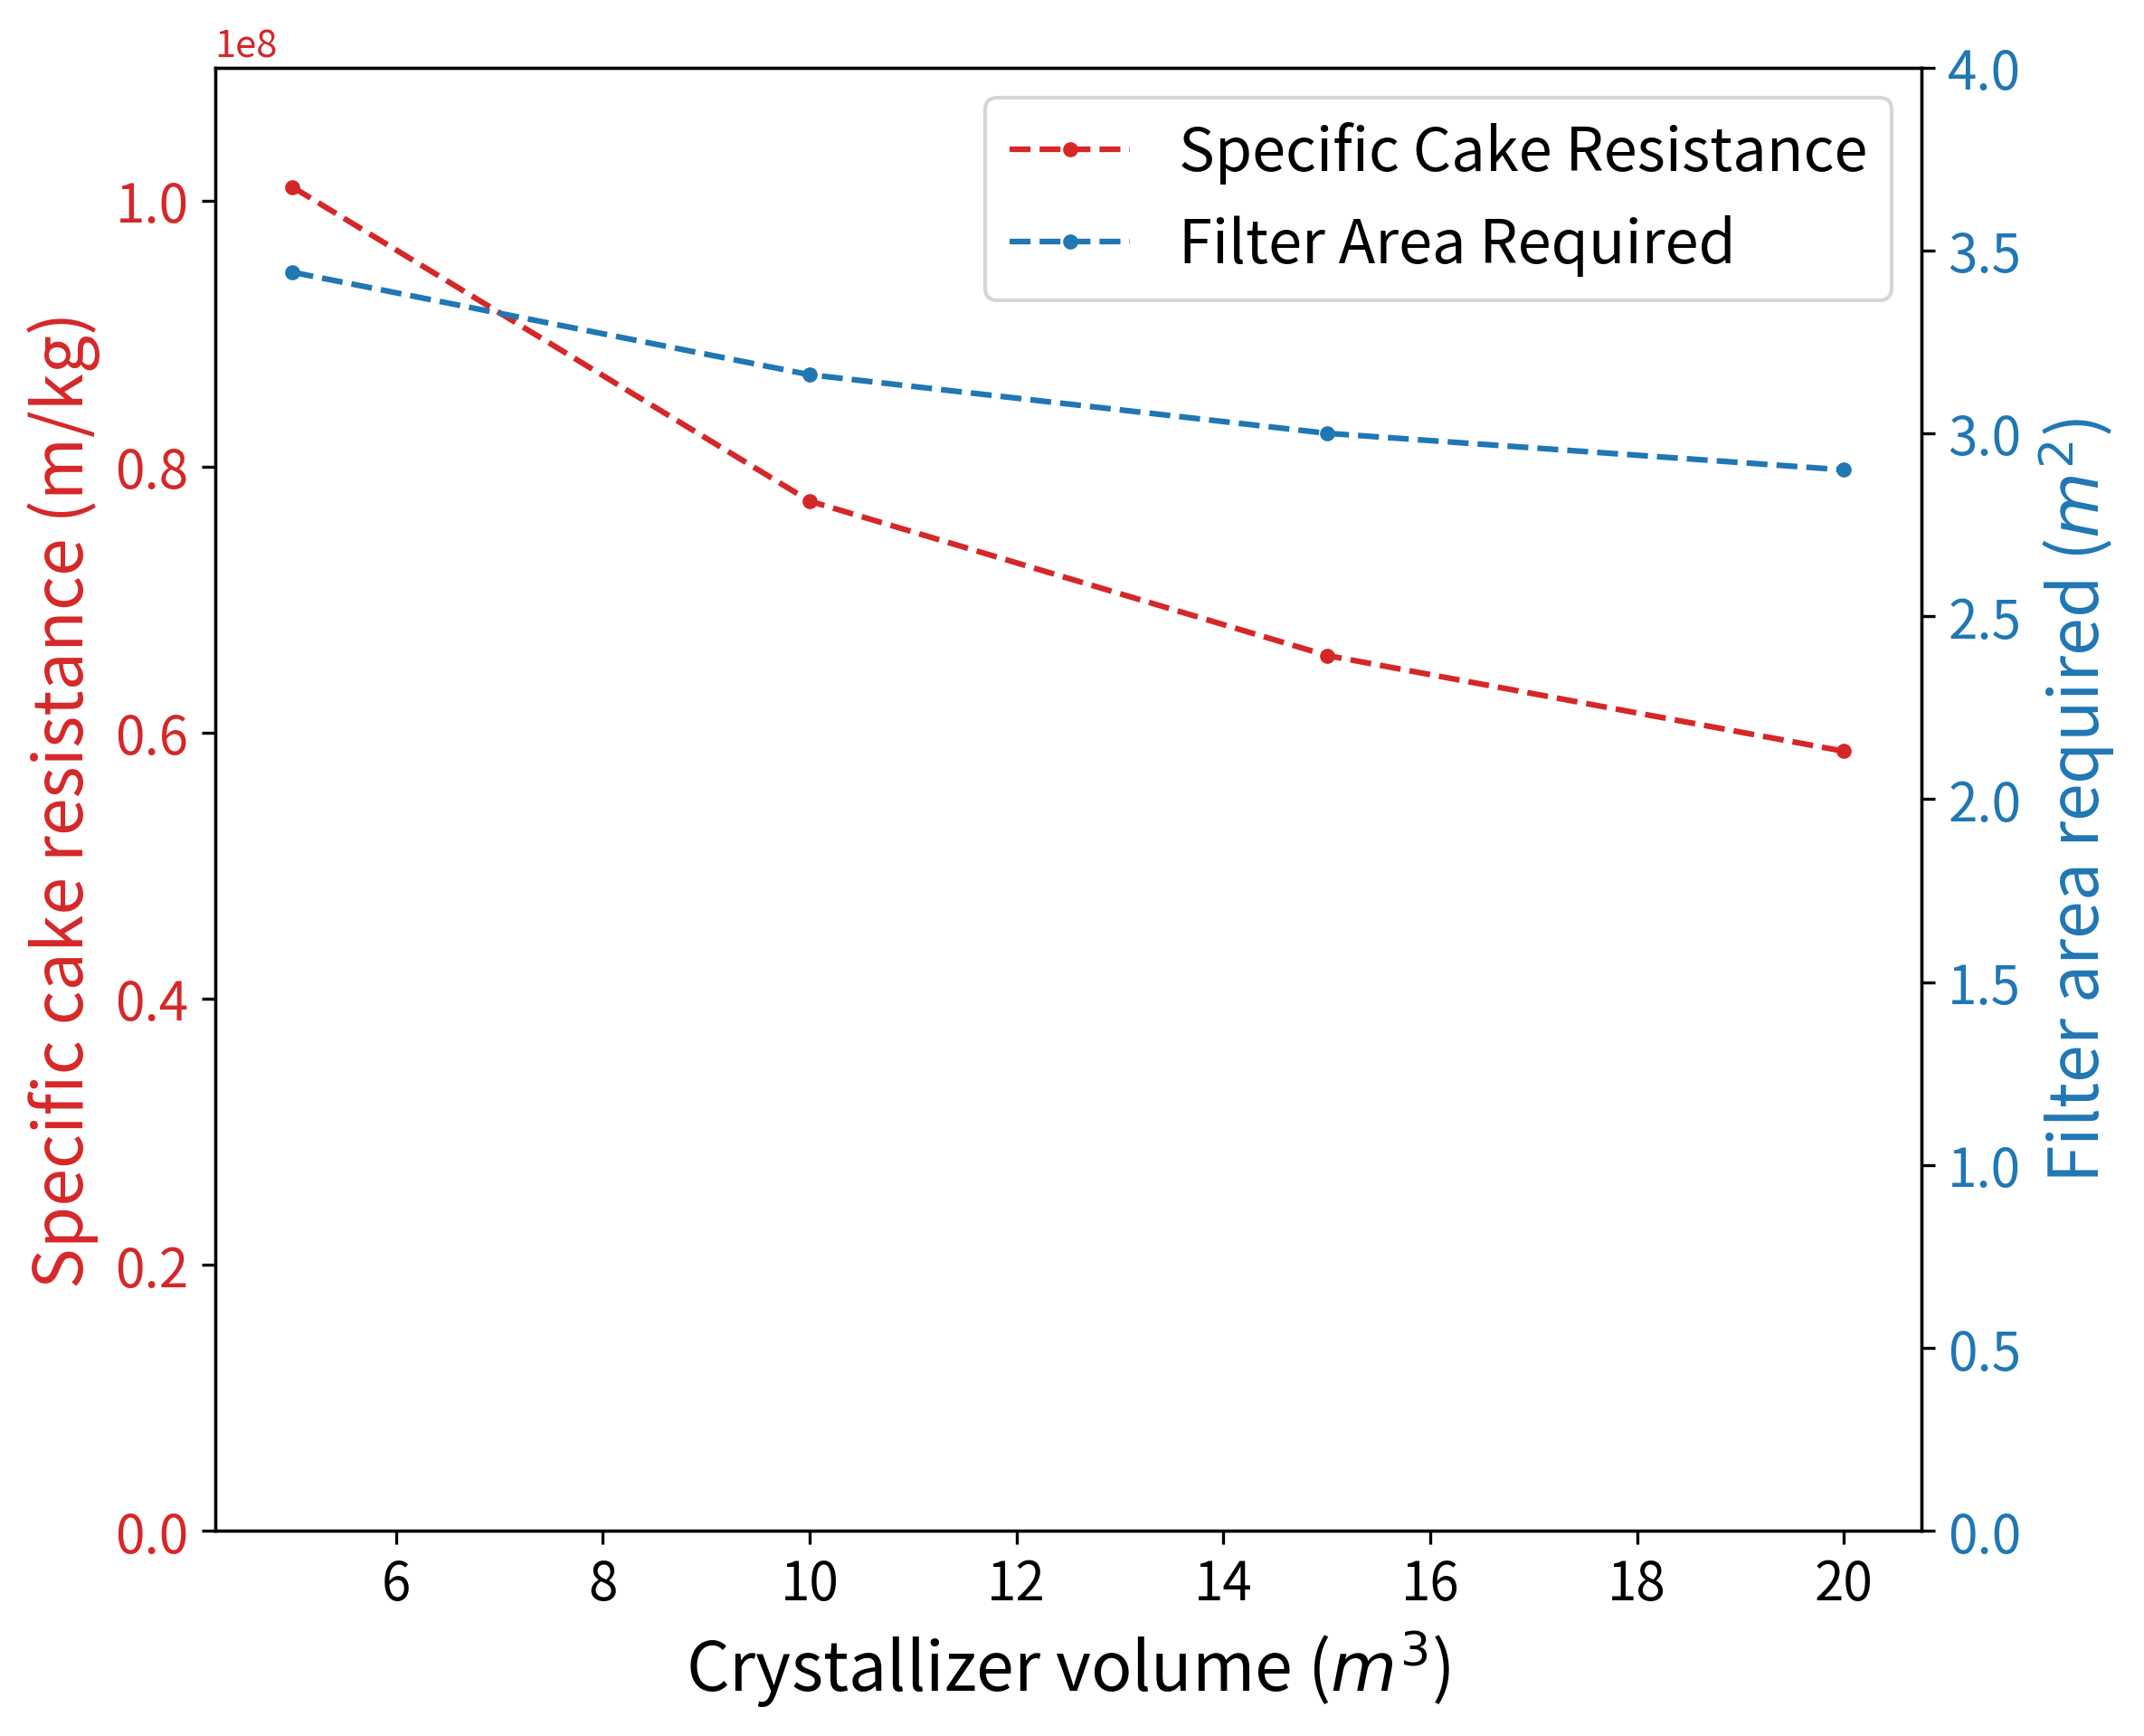
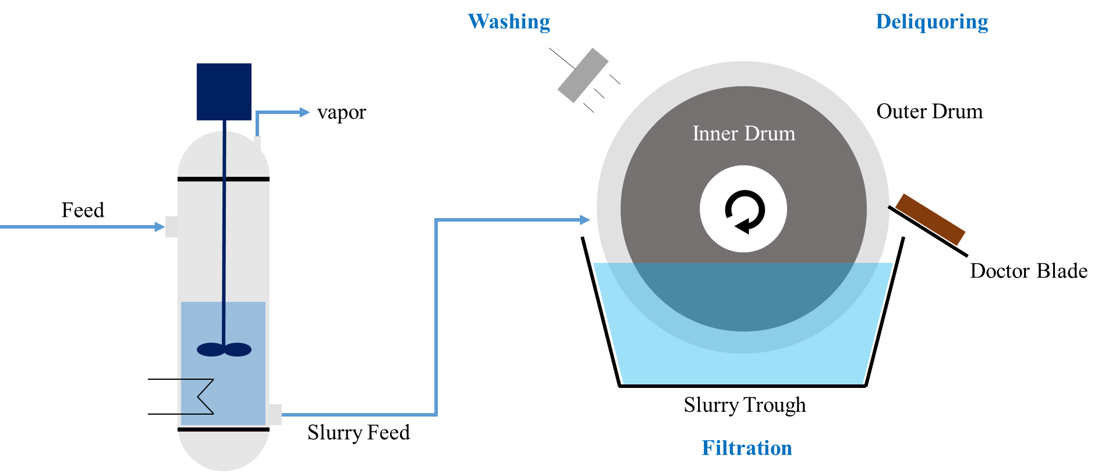
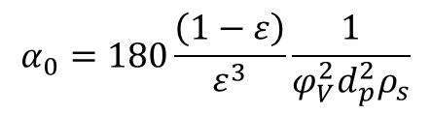
Crystal Size Distribution
Discrete Element Method
+
Kozeny-Carman Equation
2
$$α_{0}=180\frac{\left(1−ε\right)}{ε^{3}}\frac{1}{φ_{V}^{2}d_{p}^{2}ρ_{s}}$$
3
Specific Cake Resistance
1
4
Crystallizer
Filter

